Slide 1
CAPSTONE PROJECT TOTO NUMBERS PREDICTION
Nhi Vo
15/April/2023

Slide 2
Agenda
Business Context
Business Question
Data Pipeline
Data Summary
Data Visualization
Modelling
Summary
Next Steps

Slide 3
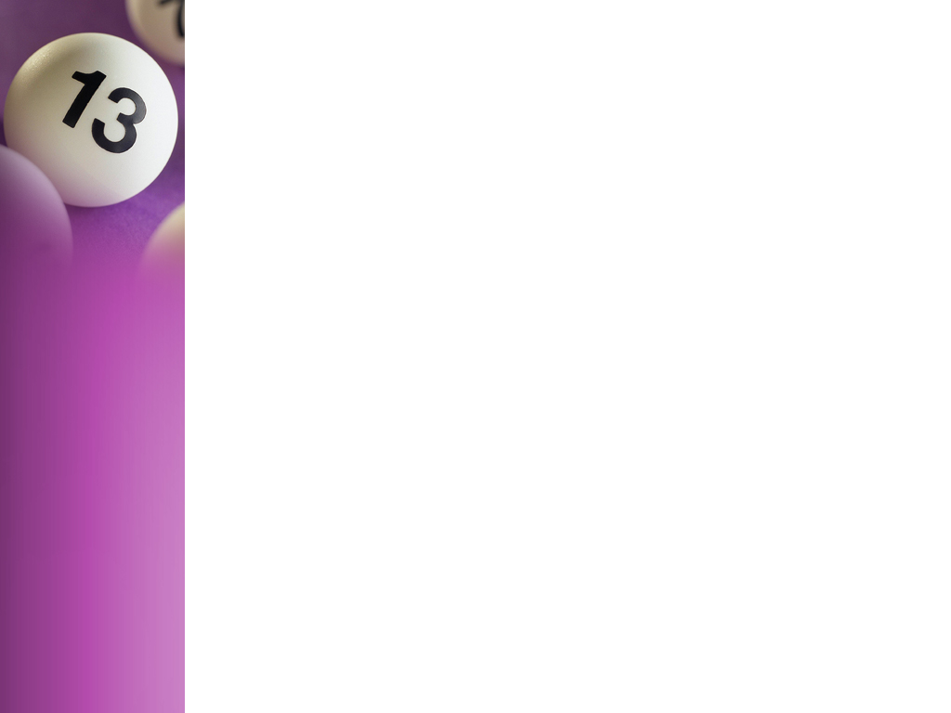
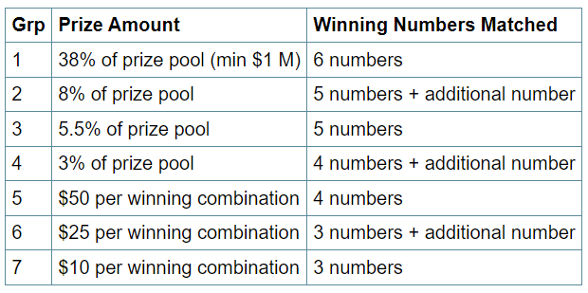
TOTO Game in Singapore
58% of Singaporean have participated in the lottery at least once over the last year.

Slide 4
TOTO Game in Singapore
Number1 | Number2 | Number3 | Number4 | Number5 | Number6 | Additional Number
? (1-49) | ? (1-49) | ? (1-49) | ? (1-49) | ? (1-49) | ? (1-49) | ? (1-49)
correct | correct | correct | correct | correct | correct
Jackpot prize

Slide 5

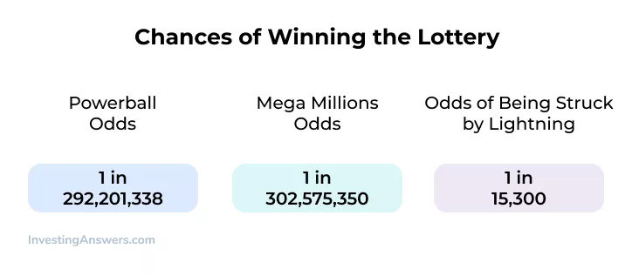
Business Question

Slide 6
Data Pipeline
Pre-processing Data
Standardize data
Transform data values
Modelling
Classification models
LSTM Model
Evaluation
Accuracy scores
Train, test scores
Summary
Limitations
Improvements
Achievements

Slide 7
Data Summary
Dataset: from Kaggle website
Sample size: 1425
Timeline: 2008-2022
Variables:
6 winning numbers
1 additional number

Slide 8
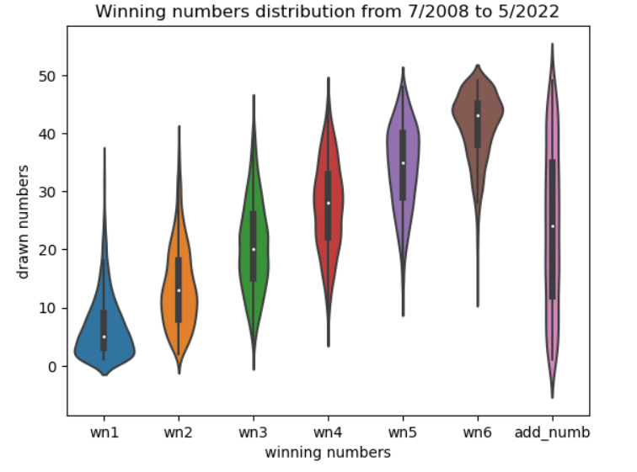
Numbers Distribution

Slide 9
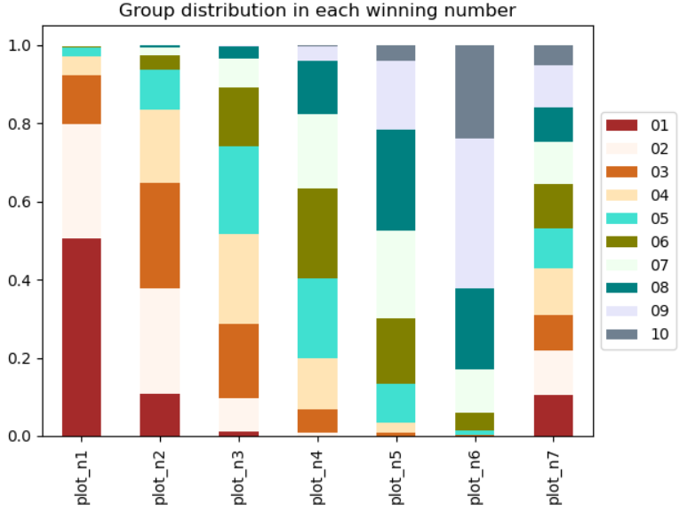
Groups of Numbers Distribution

Slide 10
Scenarios analysis
24 graphs
TF_IDF Pre-processing data
Count_Vectorizer Pre-processing data
Observed days:
90
120
180
Cross validation data:
Shuffle both Xs, ys
Shuffle Xs, not shuffle ys

Slide 11
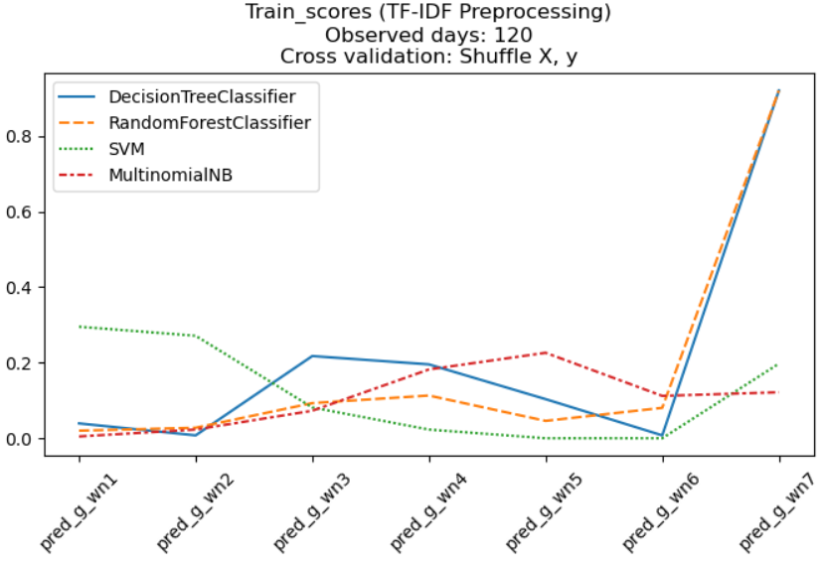
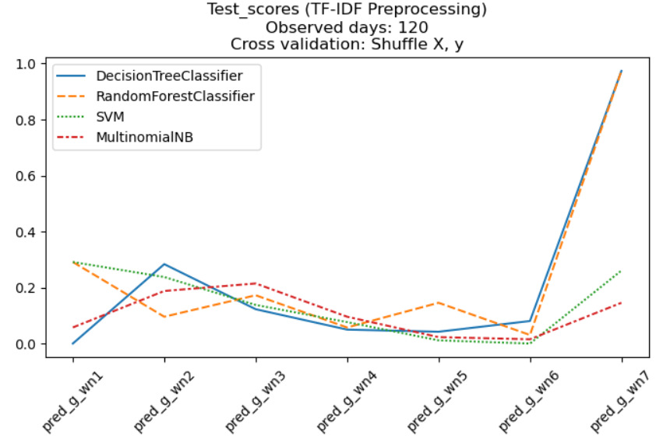
Best case of TF_IDF Scenario 1
Decision Tree Classification Model:
3 correct numbers + 1 additional number: 8/267 cases (3%)

Slide 12
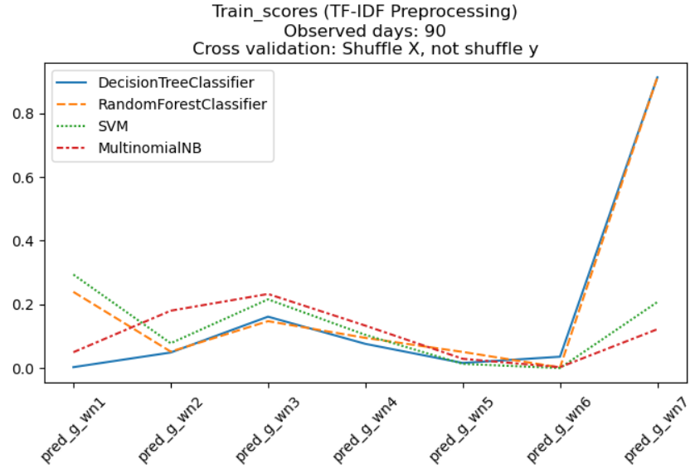
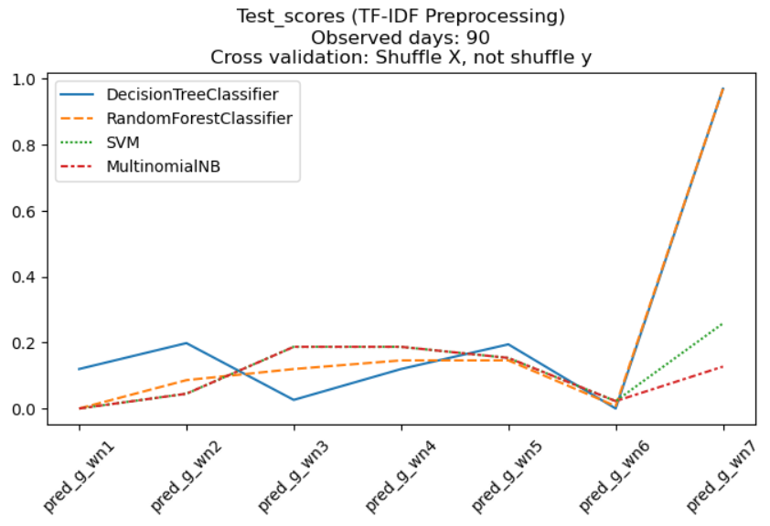
Best case of TF_IDF Scenario 2
Random Forest Classification Model:
3 correct numbers + 1 additional number: 12/267 cases (4.5%)

Slide 13
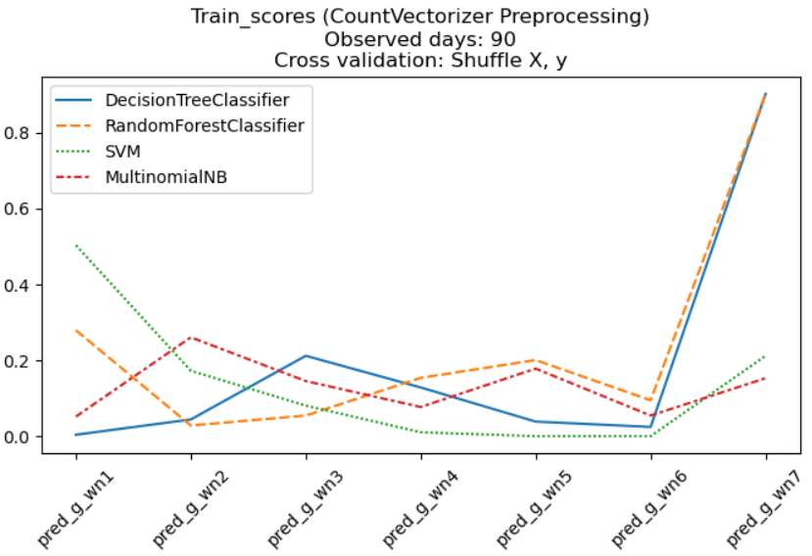
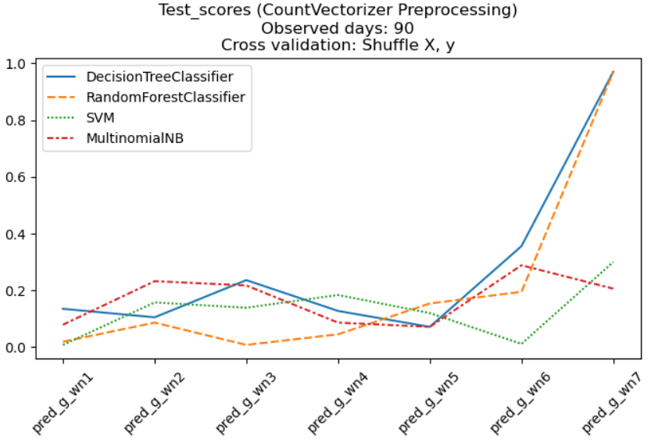
Best case of CountVectorizer Scenario 1
Random Forest Classification Model:
3 correct numbers + 1 additional number: 9/267 cases (3.4%)

Slide 14
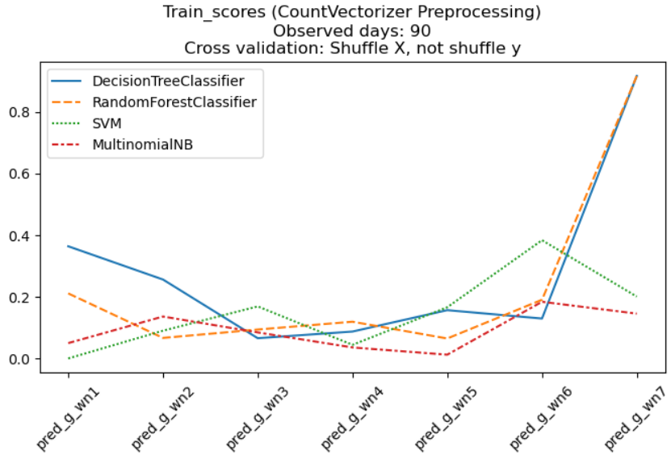
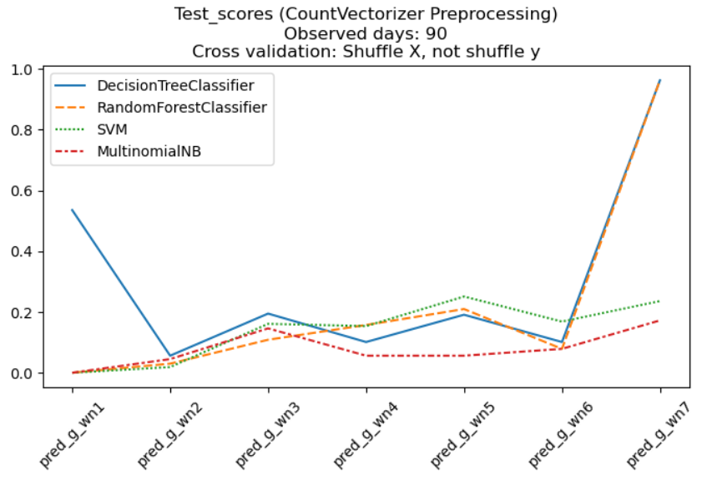
Best Case of CountVectorizer Scenario 2
Random Forest Classification Model:
3 correct numbers + 1 additional number: 19/267 cases (7.1%)

Slide 15
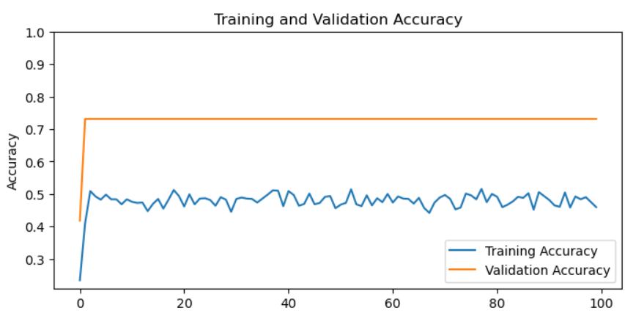
Neural Network LSTM Model

Slide 16
Lottery winning chance LSTM Model
Test size: 201 cases
3 correct numbers: 42 cases (21%)
4 correct numbers: 10 cases (5%)
5 correct numbers: 3 cases (1.5%)
Correct the additional number: 19 cases
Minimum Prizes given (at least 3 correct numbers and one additional number): 5 cases (2.5%)

Slide 17
Conclusion
Preprocessing data: CountVectorizer
Random Forest Classification Model
Best model with 7% accuracy of predicting 3 groups of 3 winning number and 1 group of additional number
Best scenario:
Observed days: 90
Shuffle Xs, not shuffle ys

Slide 18
Limitation of Models
Problems with the current dataset
Unbalance
Inconsistent distribution among numbers
Small sample size

Slide 19
Further Model Development
Increase the sample size
Add more features:
Withdrawn day
Value of the periodic prize pool

Slide 20


